Slide 1
CLAS 220 Introduction to Classical Mythology
Ovid, Metamorphoses 9-12

Slide 2
Final Exam Practice Questions
Which of the following is NOT characteristic of a Greek God?
Good by nature
Extreme
Unseasonal
Has a divine antagonist

Slide 3
Final Exam Practice Questions
2. Which of the gods or goddesses is concerned with the grape harvest, wine-making, and tragedy?
Apollo
Demeter
Dionysus
Hermes

Slide 4
Final Exam Practice Questions
3. Who kidnaps Demeter’s daughter?
Poseidon
Apollo
Hades
Zeus

Slide 5
Final Exam Practice Questions
4. What is the name of Achilles’ mother?
Theuth
Thetis
Venus
Vesta

Slide 6
Final Exam Practice Questions
5. For whom does Achilles hold funeral games?
Patroclus
Hector
Agamemnon
Anchises

Slide 7
Final Exam Practice Questions
6. What is the name of the princess who rescues Odysseuss on the island of the Phaeacians?
Nestoria
Nausicaa
Niobe
Dido

Slide 8
Final Exam Practice Questions
7. What is the one thing Tiresias tells Odysseus not to do when they’re in the underworld?
Sacrifice to Poseidon
Marry Nausicaa
Kill the oxen of the sun-god
Eat the Lotos

Slide 9
Final Exam Practice Questions
8. Which of the following people does Medea NOT kill in Euripides’ play?
Kreon
Glauke
Her children
Jason

Slide 10
Final Exam Practice Questions
9. What is the name of Aeneas’ first wife?
Creusa
Dido
Lavinia
Ceres

Slide 11
Final Exam Practice Questions
10. What is the name of King Latinus’ wife? a. Allecto
b. Camilla
c. Dido
d. Amata

Slide 12
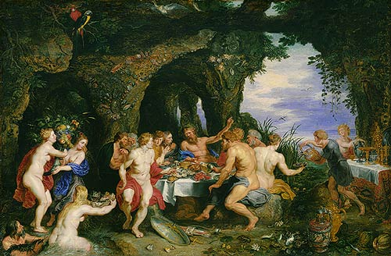
6. Achelous and the Nymphs
Theseus, in returning home, runs into river Achelous, who is flooding
Achelous oldest and greatest of rivers
River invites Theseus into his home to hear stories
Includes Achelous’ own story; more nymphs chased by god, then turned into islands to escape him

Slide 13
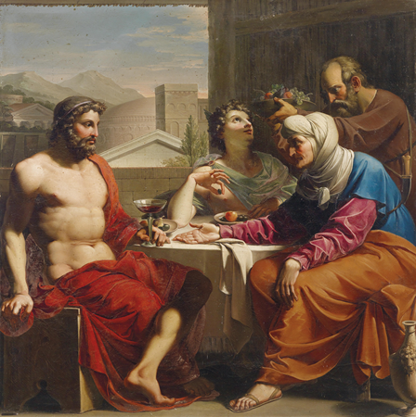
6. Baucis and Philemon
Happier story of gods and men
Jupiter and Mercury, angry at men, visit earth to test them
Arrive at cottage of Baucisd and Philemon, elderly peasants
Baucis and Philemon feed them well despite their poverty, willing to kill only goose for guests
Gods reward them by sparing them from flood;
Also grant them wish to die together
Which they do, and turn into tree with two trunks

Slide 14
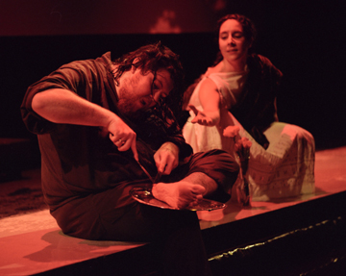
6. Erysichthon and his Daughter
Opposite story; about greed
Erysichthon is a bad guy
Cuts down sacred tree
Punished by Ceres with perpetual hunger
Sells daughter into slavery
But she’s a shape-shifter so she turns into fisherman and escapes
Erysichthon turns this into a regular scam
Eventually becomes so hungry that he starts eating himself.

Slide 15
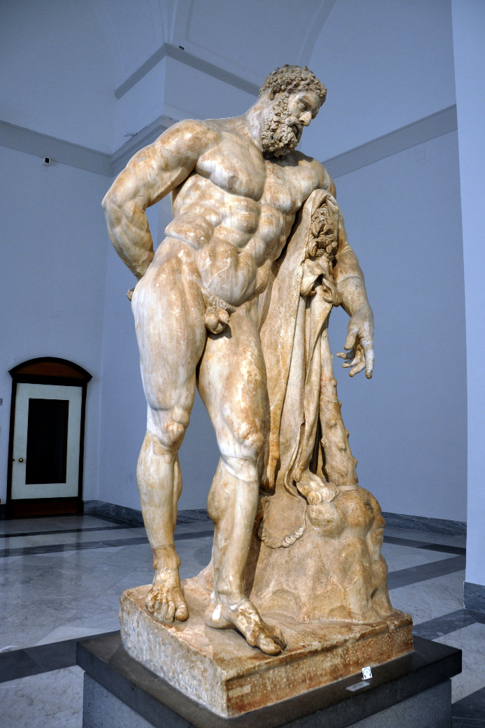
6a. Hercules Cycle
in many ways, the greatest of the Greek heroes
famous for his Twelve Labors
of the generation before the Trojan War
Becomes important to the Romans, too (see Aeneid VIII)
typically, Ovid gives us Hercules' story, but indirectly, and with emphasis on unlikely elements
remember, too, this is all being told by Achelous to Theseus, Hercules' companion and rival

Slide 16
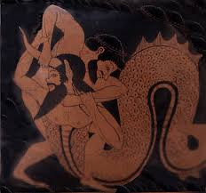
6a. Hercules Cycle: Acheolous and Heracles
the river-god tells Theseus about
how he once wrestled with Heracles, and lost
both were rival suitors of Deianira
Achelous changes form to a snake, and then a bull;
Heracles is able to defeat him in both forms
echoes of:
Proteus and Menelaus
Achilles and Scamander/Xanthus

Slide 17
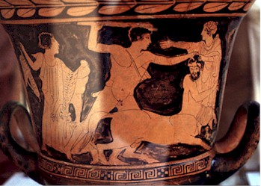
6a. Hercules Cycle: Nessus and Deianira
another story of Hercules and Deianira
they're about to cross the river Euenus
on their way home to Heracles' city of Tiryns
the Centaur Nessus helps Deianira across
-- and rapes her on the other side of the river
Heracles wounds him; Nessus plots revenge
gives Deianira a shirt drenched in his
toxic blood, says it's a love potion
when Hercules is out on an adventure,
he's with the beautiful Iole; Deianira becomes
jealous (in other sources, Hercules and Iole definitely get married)
she sends the shirt of Nessus to Heracles to win him back

Slide 18
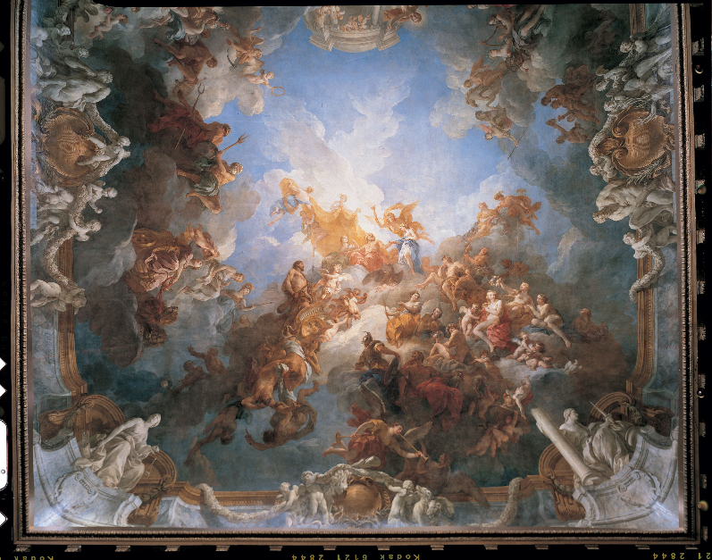
6a. Hercules Cycle: Apotheosis of Heracles
Hercules puts on the shirt of Nessus
burns with pain
builds his own funeral pyre
Jove takes pity on him
the mortal parts of Hercules
will die on the pyre
the immortal parts will become a god
in this episode, Hercules recites all
of his adventures -- the Twelve Labors
and some much more obscure ones

Slide 19
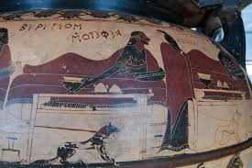
6a. Hercules Cycle: Iole and Alcmene converse
After Hercules' death, Iole (now engaged to Hyllus) and Hercules' mother, Alcmene, converse, and share a number of stories:
The birth of Heracles
Dryope
Iolaus and the sons of Callirhoe
Byblis
Iphis and Ianthe

Slide 20
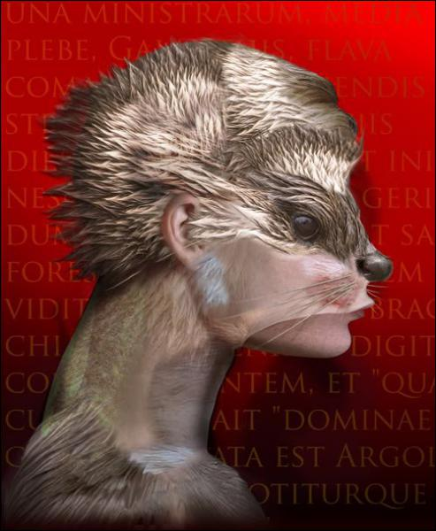
6a: The birth of Heracles
the most familiar story here is how Juno tried to kill the baby Hercules by sending twin snakes to his cradle, and then Hercules strangles them with his bare hands.
Here, we get a different story:
as Alcmene is giving birth, Juno tries to stop her
finally, her maid Galanthis tricks Juno by pretending that Alcmene
has already given birth
Galanthis turned into a weasel

Slide 21
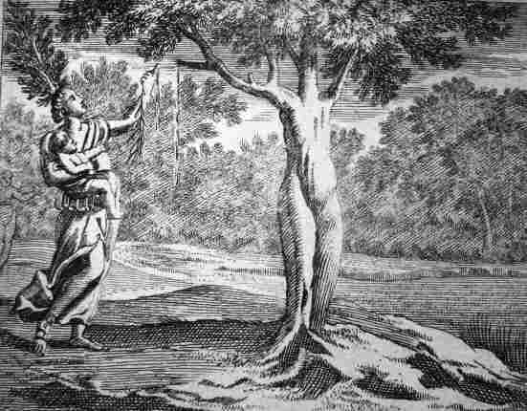
6a: Dryope
Iole tells story about her sister Dryope
Dryope raped by Apollo
Andraemon marries her; she has small baby, nurses him under a shrub
picks flowers from shrub to please baby
shrub bleeds; it's the nymph Lotis,
who had fled Priapus
Dryope herself turned into a tree:
…but now in terror tried
to turn away and leave, but found her feet
rooted. She fought to free herself, but failed
to move below her bosom. Gradually
up from the soil right around her legs and loins
bark climbed and clung; and, seeing it, she tried
to tear her hair, but found leaves filled and her hand,
leaves covered her whole head. Her little boy,
Amphissos... could feel his mother's breasts
grow hard; the milky flow failed as he sucked."

Slide 22
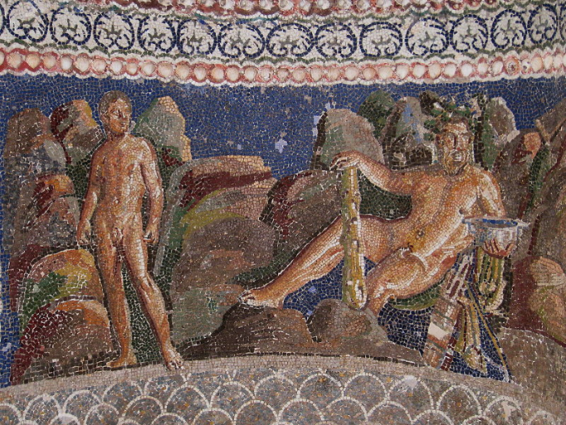
6a: Iolaus and the sons of Callirhoe
suddenly, there appears Iolaus, Hercules' companion, restored to his full youth
it turns out that Hebe, the goddess of youth (and a wife to Hercules) has taken years off his life, and given them to the sons of Callirhoe
Callirhoe is the daughter of Achelous and second wife of Alcmaeon;
she wants Alcmaeon to get her Harmonia's necklace,
but Alcmaeon is killed before he can give it to her
she wants her boys to grow up faster than usual to get revenge

Slide 23
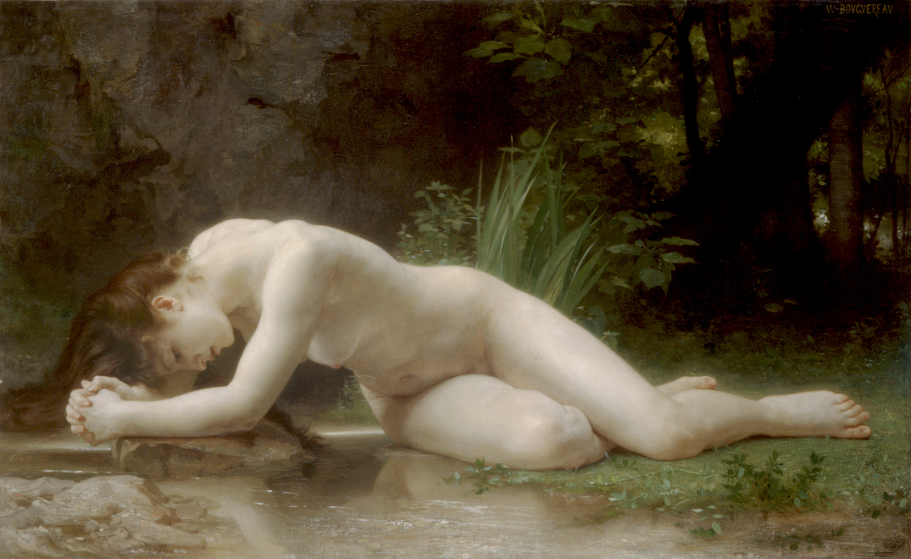
6a: Byblis
Jove says that's enough playing with the age of people;
says that if he could, he would have restored King Minos his youth.
Segue to Minos' son, Miletus, who moves to Asia Minor,
and then to his twin children Byblis (daughter) and Caunus (son)
Byblis falls hopelessly in love with her twin brother
she tries to seduce him; he spurns her; she tries harder
he runs away; she pursues him
eventually she collapses in the forest
wood-nymphs comfort her, and she's turned into a spring.

Slide 24
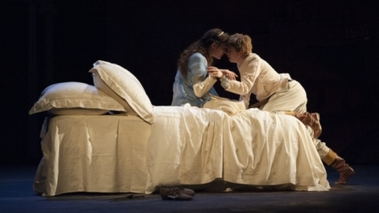
6a: Iphis and Ianthe
Back to Crete (where Minos, Byblis' grandfather, is king).
There, a poor man, Ligdus, has a pregnant wife
he prays that they have a son, because they can't afford a daughter.
They have a daughter, whom Ligdus' wife
raises as a boy, with the ambiguous name Iphis
All is well until Iphis grows up, and is engaged to
Ianthe, who is a biological female
Iphis falls in love with Ianthe, but is terrified of
Ianthe discovering the truth
Then Isis turns Iphis into a man:
At her side
walked Iphis, as she went, with longer strides
than usual, her cheeks of darker hue,
her features firmer, limbs more powerful,
her hanging tresses shorter, and her strength
greater than woman's wont. She who had been
a girl a moment past was now a boy.

Slide 25
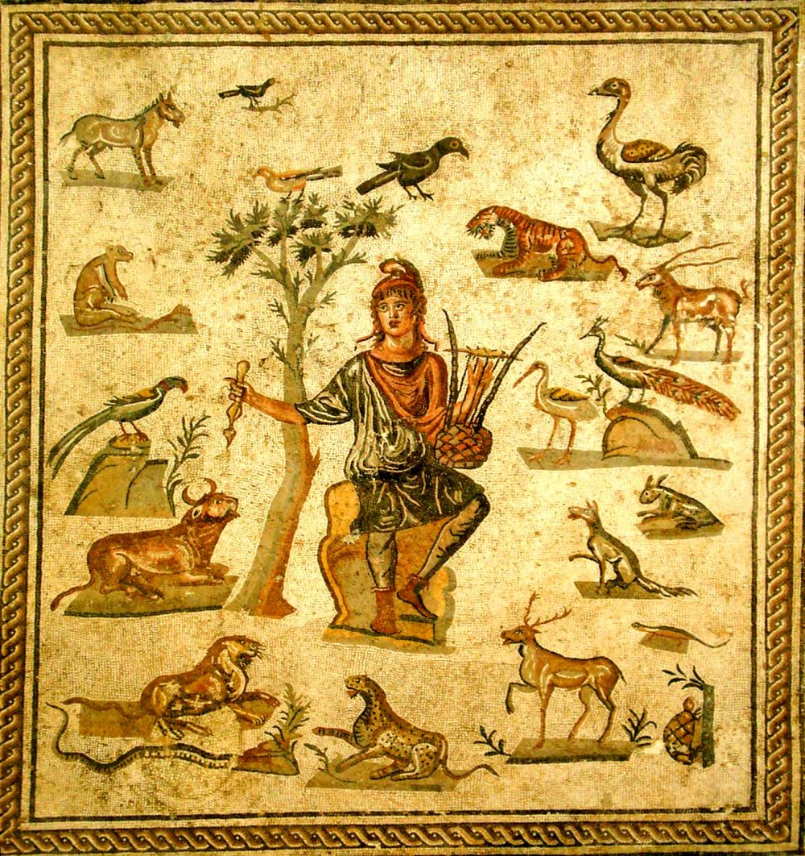
7. Orpheus Cycle
Orpheus one of the most famous figures in Greek myth
when he's a boy, Apollo gives him a lyre, and he becomes a musician
marries Eurydice, but on their wedding day she dies
(in some versions, she's assaulted by a Satyr,
then in escaping him falls into a pit of vipers)
Orpheus is devastated, but goes to the underworld and begs Pluto to let him have wife back.
He sings so beautifully that Pluto agrees, on the condition that Orpheus not look back
Orpheus does, and Eurydice dies again
Afterwards, Orpheus invents homosexuality
then torn to pieces by Maenads
Also associated with mystery religion
Again, Ovid doesn't emphasize the main parts of the story, and uses Orpheus' reputation as a singer to tell all sorts of unrelated stories

Slide 26
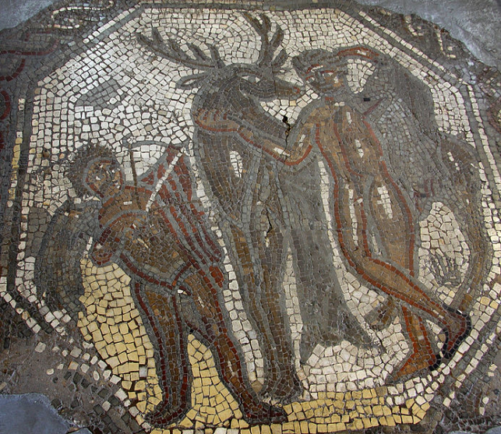
7. Cyparissus
Orpheus is such a great singer that the very trees assemble to hear him sing.
Except for the cypress...
Cyparissus was a beautiful boy whom Apollo loved
he used to be friendly with a stag sacred to the nymphs
one day he accidentally kills the stag, and is inconsolable with grief.
He begs to be allowed to grieve forever, and Apollo turns him into the cypress tree.
Cf. Ascanius killing Silvia's
sacred deer in Aeneid 7

Slide 27
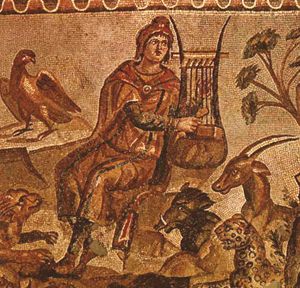
7. The Songs of Orpheus
Orpheus begins with invocation:
"From Jove, great Mother Muse,
Inspire my song: to Jove all creatures bow;
Jove's might I've often hymned in days gone by.
I sang the giants in a graver theme
and bolts victorious in Phlegra's plains.
But now I need a lighter strain, to sing
of boys beloved by gods, and girls bewitched
by lawless fires who paid the price of lust."
Orpheus begins to sing to the assembled trees and others
Many of these stories are of different kinds of unconventional love

Slide 28
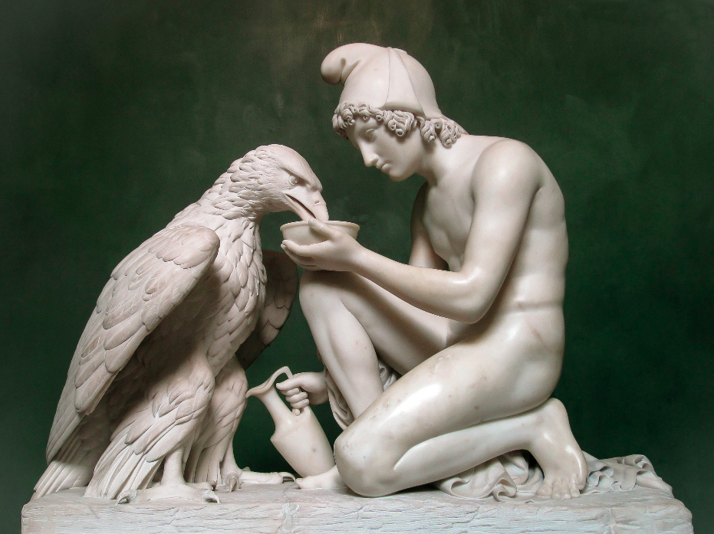
7. Songs of Orpheus: Ganymede
Ganymede a mortal boy whom Jove falls in love with.
Jove turns into an eagle and brings Ganymede up to the heavens to be his cupbearer

Slide 29
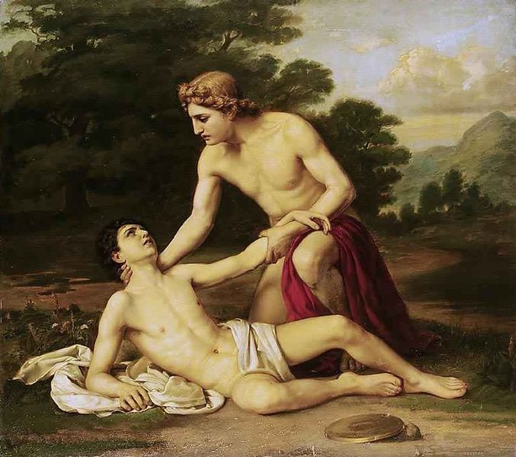
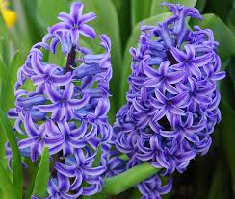
7. Songs of Orpheus: Hyacinth
Apollo falls in love with a Spartan boy, Hyacinthus.
He forgets to play his lyre,
and instead hunts with Hyacinthus
one day, they're playing with a discus,
and Hyacinthus gets hit in the head and dies
Apollo dedicates the hyacinth flower
to his beloved, decorating it with
the letters AI AI AI
for his own laments.
NB: the -nthus in the boy's name shows that it's of
pre-Greek origin
may be a god of pre-Greek peoples

Slide 30
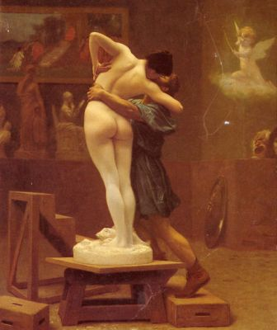
7. Songs of Orpheus: Pygmalion and Galatea
quick transition: the story of the Propoetides,
who don't respect Venus, and are turned into
temple prostitutes by her
Pygmalion, a sculptor, is disgusted by them,
and decides to make his own woman in sculpture
prays to Venus, who gives statue (Galatea) life
Pygmalion and Galatea have daughter Paphos
who gives her name to Cyprus.
"And he went home, home to his heart's delight,
and kissed her as she lay, and she seemed warm;
again he kissed her and with marvelling touch
caressed her breast; beneath his touch the flesh
grew soft, its ivory hardness vanishing

Slide 31
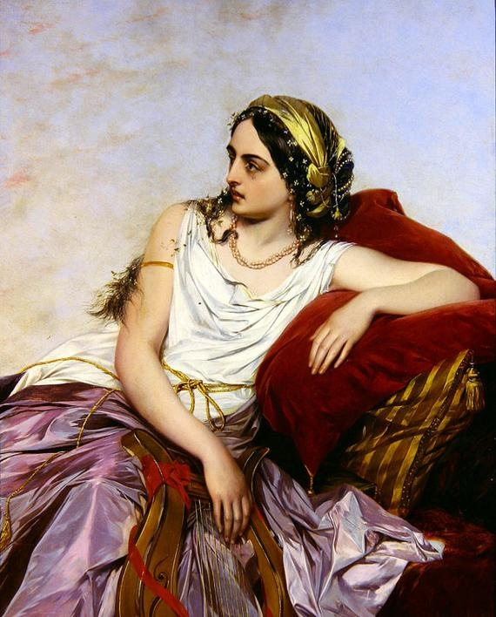
7. Songs of Orpheus: Myrrha
Paphos has a son Cinyras
his daughter, Myrrha, falls in love with him
she tries to kill herself rather than give in to desire
her nurse stops her, and eventually agrees to help her
during a festival of Ceres, women are supposed to abstain from sex
the nurse tells Cinyras that there's a girl of his daughter's age who's desperate to have sex with her in secret.
after a few nights, he discovers the truth, and tries to kill Myrrha with his sword.
Myrrha flees, wanders the Arabian desert for nine months
She's turned into a myrrh tree, and out of it is born Adonis.
Away, away,
forbidden hopes! He's worthy of my love,
Yes, but as father. --- Well then, were I not
great Cinyras' daughter, i could lie
with Cinyras. But now because he's mine,
he isn't mine! Propinquity itself
does damage; I'd do better not so near.

Slide 32
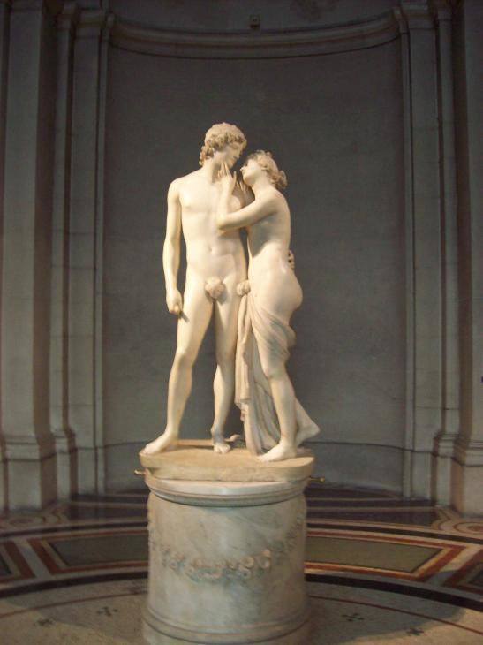
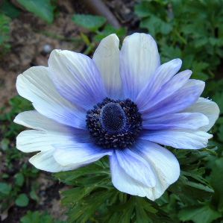
7. Songs of Orpheus: Venus and Adonis
Adonis grows to be a beautiful
young man, and Venus falls in love with him.
She neglects heaven, and joins Adonis on the hunt
She avoids hunting predators, and tells Adonis the story of Atalanta and Hippomenes ...
Adonis doesn't heed the lesson, is gored in the groin by a boar he hunts
Venus, distraught, dedicates the anemone to him

Slide 33
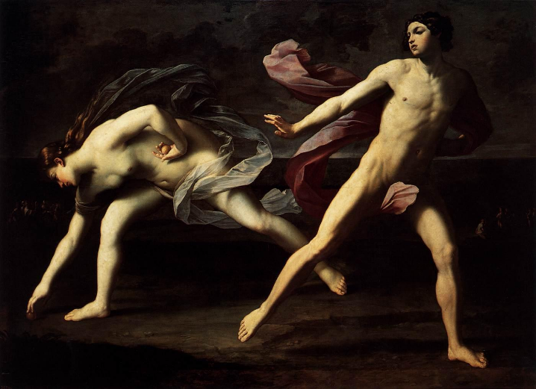
7. Songs of Orpheus: Atalanta and Hippomenes
(Told to Adonis by Venus):
A prophecy says that Atalanta can only marry
a man who defeats her in a running race.
Hippomenes falls in love with her, and prays for Venus' help.
She gets him three golden apples
which he throws to distract Atalanta, and wins.
They celebrate their marriage by having sex
in a woodland temple to the mother goddess Cybele.
Venus and Cybele are horrified,
punish Atalanta and Hippomenes by turning them into lions.

Slide 34
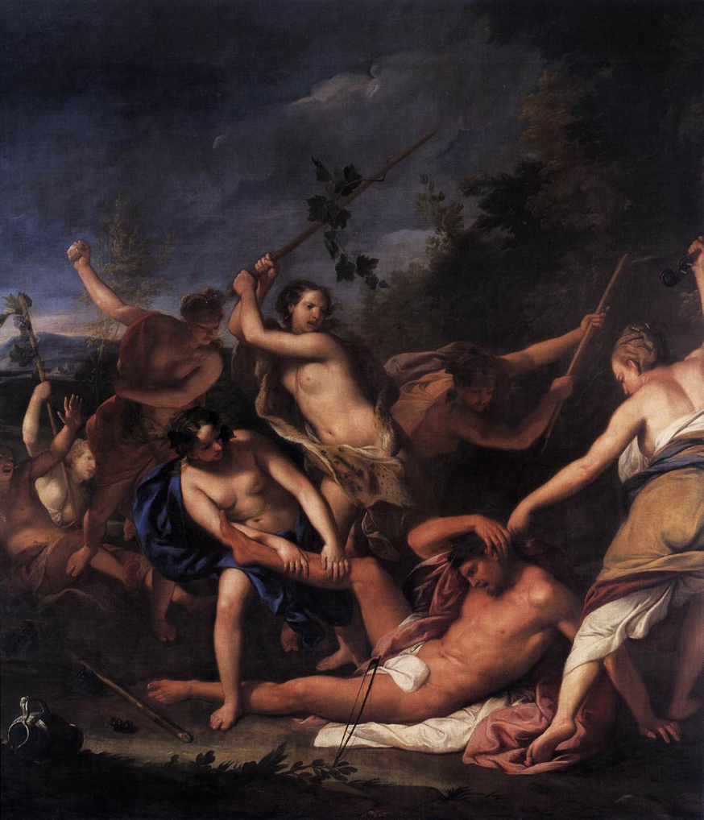
7. The Death of Orpheus
a group of Maenads are immune
to the charm of Orpheus' song
they tear animals to pieces, then Orpheus himself
he is reunited with Eurydice in the underworld
Dionysus punishes the Maenads by turning them into trees
All around his limbs
lay scattered. Hebrus' stream received his head
and lyre, and floating by (so wonderful!)
his lyre sent sounds of sorrow and his tongue,
lifeless, still murmured sorrow, and the banks
gave sorrowing reply. And then they left
their native river, carried out to sea,
and gained Methymna's shore on Lesbos' isle.
There, as his head lay on that foreign sand,
its tumbled tresses dripping, a fierce snake
threatened, till at last Apollo came...

Slide 35
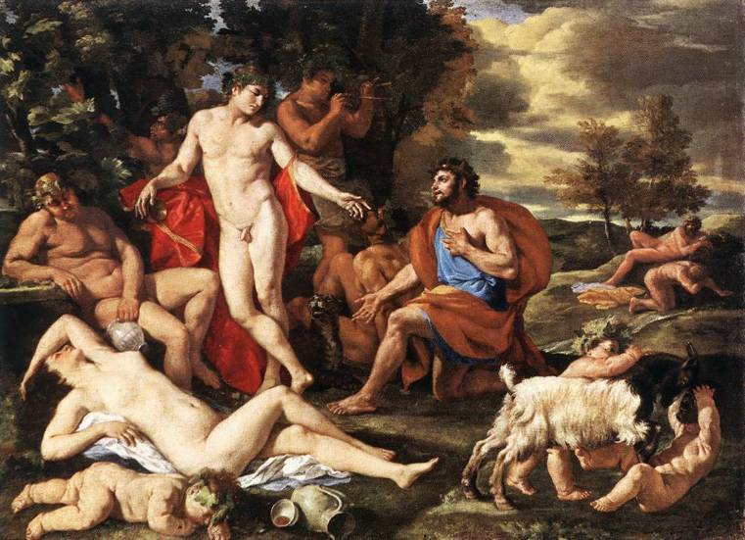
7. Midas
Bacchus leaves Thrace with his attendants, furious at the way Orpheus has been treated.
Silenus does not go with him, because he's with Midas...
Midas brings Silenus back to Bacchus, and Bacchus offers him a reward.
Midas asks that everything he touch turn to gold.
(Be careful what you wish for!)
Midas washes himself in the Pactolus river (which becomes filled with gold), and all is well.
UNTIL Apollo (lyre) and Pan (flute) have a musical competition.
The judge (Mt. Tmolus) awards Apollo the victory, but Midas disagrees.
Apollo gives Midas donkey ears.

Slide 36
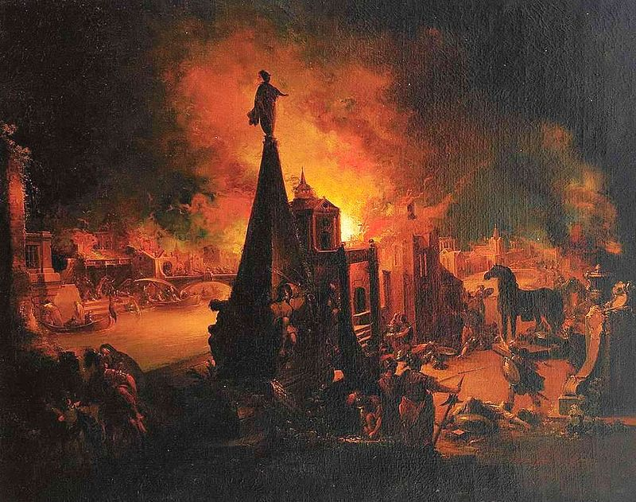
8. Troy Cycle

Slide 37
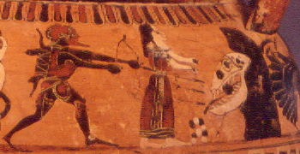
8. The Foundation of Troy
Apollo leaves Midas behind, and travels to nearby Troy, where Laomedon is building a new city.
Apollo and Poseidon help him build walls for the new city, but Laomedon won't pay them.
They punish Laomedon by flooding the city, then forcing him to sacrifice his daughter to a sea monster.
Hercules rescues the daughter, and wants the horses that Laomedon's grandfather, Tros, had been given for helping with Jove's abduction of Ganymede.
Hercules doesn't get the horses, so Telamon takes Hesione to be his bride.
Telamon's brother, Peleus, meanwhile, has a bride....

Slide 38
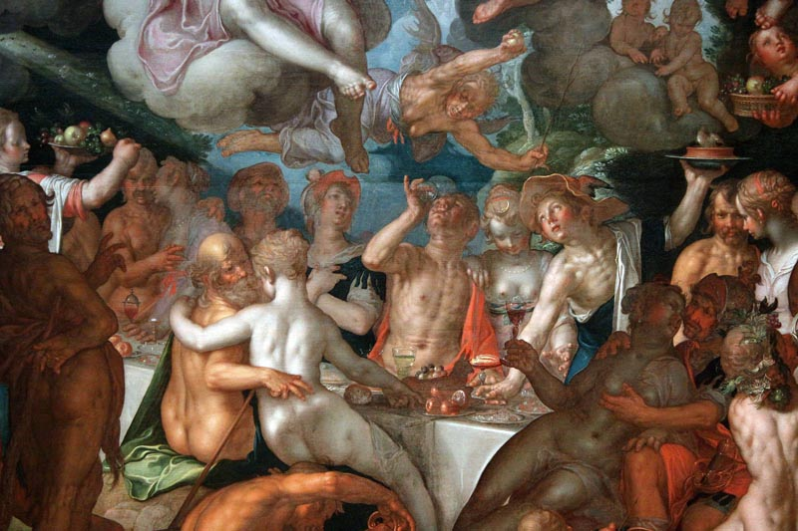
8. Peleus and Thetis
Proteus prophesied that Thetis' son would be more powerful than his father, so Jove avoids her.
Gives her instead to his grandson Peleus to marry.
Thetis is a sea-goddess, who suns herself nude in a secluded bay, with her pet dolphin.
She's also a shape-shifter,
and Proteus tells Peleus
he won't be able to have Thetis
unless he holds on until she
returns to her original form.
When she does, she is his.

Slide 39
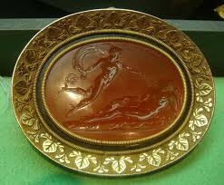
8. Daedalion and Chione
Peleus and Thetis, and their son Achilles, live happily ever after, except for Peleus' murder of his half-brother Phocus.
He seeks asylum with King Ceyx in Trachis,
who is himself troubled by his brother Daedalion.
Daedalion has a daughter Chione, who is wooed by
both Apollo and Mercury.
She has twins, one by each of them.
She brags to the gods, and Diana punishes her
by shooting her in her tongue.
Daedalion goes mad with grief, and turns into a hawk.

Slide 40
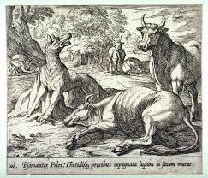
8. The Cattle of Peleus
While Peleus and Ceyx are talking, a messenger reports that a savage wolf has killed all of Peleus' cattle.
Ceyx wants to fight back, but Peleus knows this is his punishment for killing Phocus.
Peleus prays to Psammanthe, a nymph, to spare his flock, without success, but then Thetis intervenes for him, and the wolf is turned to marble.

Slide 41
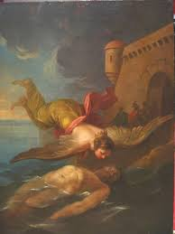
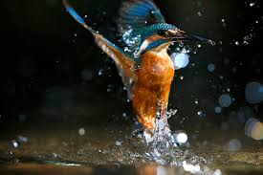
8. Ceyx and Alcyone
Ceyx heads to the oracle of Apollo at Claros to learn more.
His ship is destroyed en route and he drowns.
Alcyone prays for him at the temple of Juno,
who then sends Iris to get Sleep to send a vision of the drowned Ceyx to Alcyone.
When she wakes from this dream, she goes to the water, and sees her husband's body floating out at sea.
She tries to drown herself, and is turned into a kingfisher, as is her husband.
Kingfishers are said to make their nests
on the ocean when the waves are calm.
"Halcyon days"

Slide 42
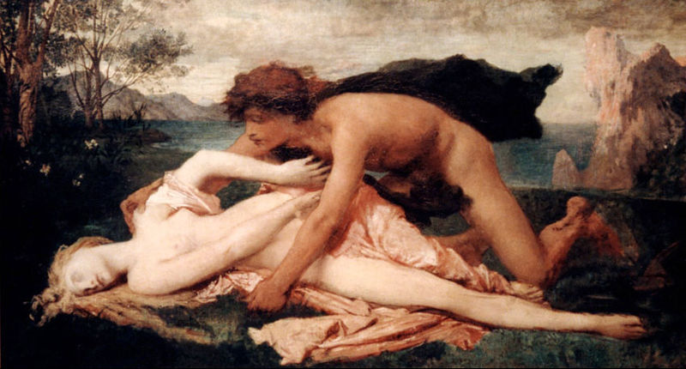
8. Aesacus
Aesacus is Hector's half-brother son of
Priam and Alexiroe.
He keeps to the woodlands, and falls in love with Hesperie, daughter of the river Cebren, near Troy.
He spies on her bathing, and, startled, she flees, only to be bitten by a snake. She dies.
He wishes he could die, and jumps off a cliff, but is turned into a diving bird.

Slide 43
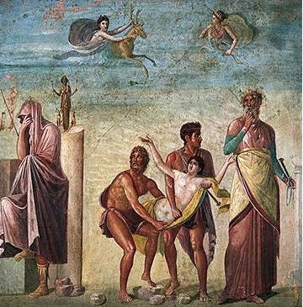
8. The Trojan War Begins
Priam mourns for Aesacus,
and all Troy joins in...
except for Paris, who is seducing Helen.
The Greek ships assemble at Aulis
to head to Troy, but winds hold them back.
The prophet Calchas tells them they need to
sacrifice Agamemnon's daughter Iphigenia,
but at the last minute Diana substitutes a deer.
The Greeks reach Troy. Protesilaus jumps off the ship, and is killed by the Trojans.

Slide 44
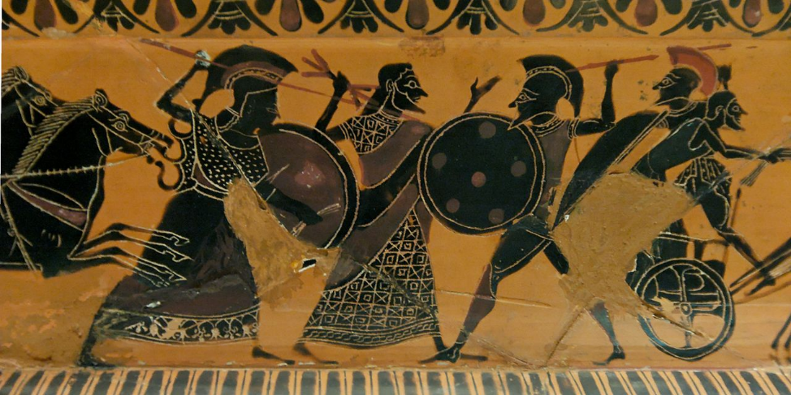
8. Achilles and Cycnus
Achilles fights Neptune's son Cyncus, who can't be hurt with iron weapons.
Achilles throws his spear over and over again, but nothing happens.
Finally, Achilles thinks he's killed Cyncus, but he's been turned into a swan instead.
At their next feast day, the Greek soldiers compare battle-stories.
Achilles brags about his defeat of Cyncus, but Nestor says he knows a better story....

Slide 45
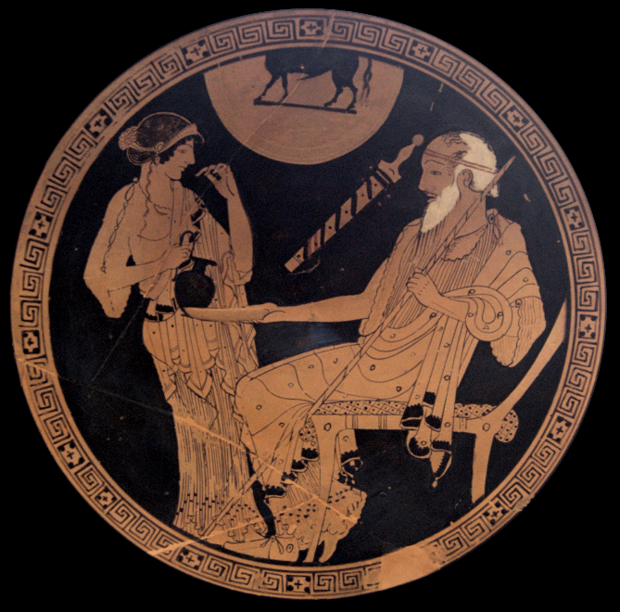
8. Nestor’s Tales
Even in Homer, Nestor is always
telling stories about the good old days
This gives Ovid the perfect opportunity
to tell some more unusual stories...
Caenis
Lapiths and Centaurs
Nestor and Hercules

Slide 46
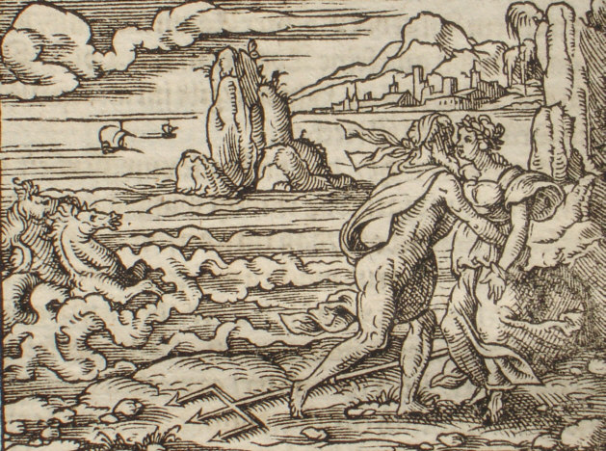
8. Nestor’s Tales: Caenis
Caenis was born as a girl
extremely beautiful, courted by all
would have been courted by Peleus,
if he wasn't already married
raped by Neptune, he grants her a wish
she asks to be a man, so that she
won't go through that again
She becomes Caeneus.
Neptune also makes him
invulnerable to wounds.

Slide 47
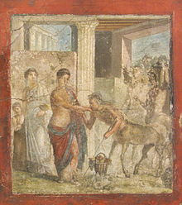
8. Nestor’s Tales: Lapiths and Centaurs
Pirithous (Theseus' "close friend") is marrying Hippodamia
and invites the centaurs to his wedding.
The centaurs get drunk, and abduct all the women
a bitter battle ensues, and Caeneus, invulnerable, is a big asset to the Lapiths (Pirithous et al.).
The centaurs, furious that they can't wound Caeneus, decide to crush him under a pile of rocks and trees, but he turns into a bird.
Cyllarus' beard was just beginning,
a golden beard, and golden tresses fell
down on his shoulders reaching to his flanks.
High-mettled grace shone in his face; his neck,
chest, shoulders, hands and every manly part
seemed like a sculptor's much-praised masterpiece.
Unblemished too his equine shape, nor less
fine than his man's. With horse's head and neck
he'd make fit mount for Castor, so high stood
his chest-muscles, so rideable his back.
Jet black he was, the whole of him, save that
his tail was white and his legs were milk-white too.

Slide 48

8. Nestor’s Tales: Nestor and Hercules
Tlepolemus (Hercules' son, and a very minor character in the Iliad), asks Nestor why he doesn't mention Hercules' accomplishments in defeating the Centaurs.
Nestor explains that Hercules conquered his kingdom of Pylos, and killed 10 of his 11 brothers, including
Periclymenus, who turns into an eagle to try to avoid Hercules.

Slide 49
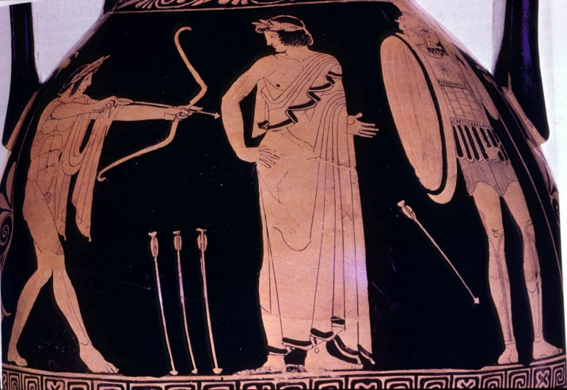
8. The Death of Achilles
We skip over the actual events of the Trojan War itself,
and move to Poseidon convincing Apollo to help Paris kill Achilles.
Apollo guides Paris' arrow, and Achilles dies.
"And so Achilles fell,
victor of mighty triumphs, vanquished by
the craven ravisher of that Greek wife:
If in a woman's fight he had to fall,
he'd have preferred the Amazon's double axe."

Slide 50
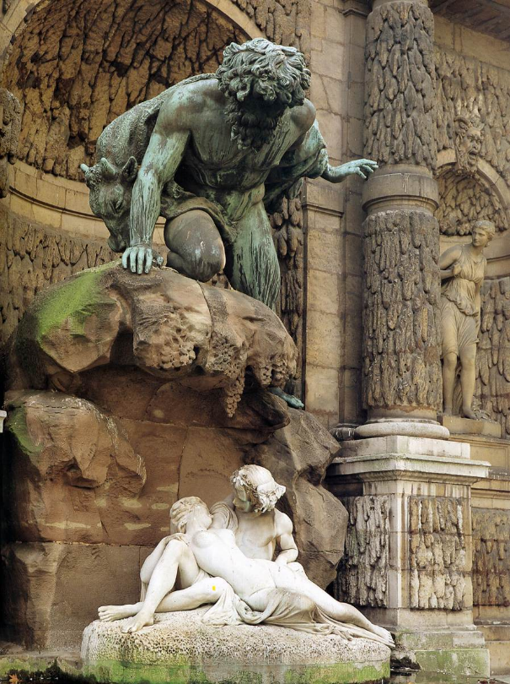
Fast-Forwarding…. Acis and Galatea
Derived from the Cyclops story
Earlier poets had had Polyphemus fall in love with the nymph Galatea; Ovid gives him a rival, Acis.
Partly a comic love triangle story, but ends with Polyphemus trying to kill Acis, who is turned into a river-god

Slide 51
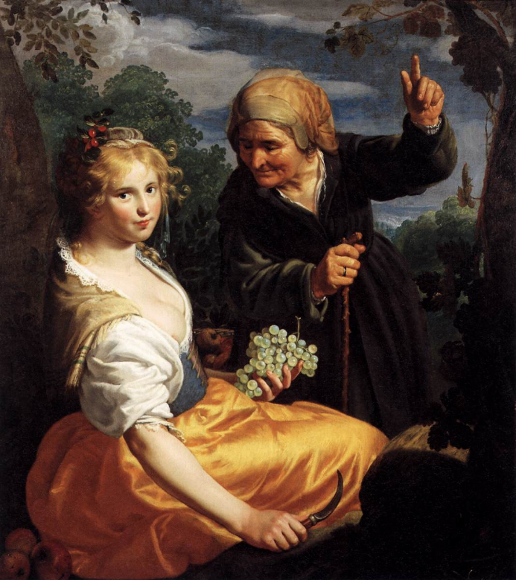
Fast-Forwarding…. Pomona and Vertumnus
Later the Roman gods of vegetation and the seasons
Pomona a beautiful young woman, skilled with plants,
but resists Venus, and the seductions of satyrs, Pan, Silenus and Priapus
Vertumnus falls in love with her, woos her in disguise.
Tries to woo Pomona in disguise as an old woman, kissing her ("but no old woman kissed quite like that")
tells story of Iphis
Iphis was in love with Anaxarete; she spurns him; he hangs himself in her doorway and she turns to stone
The story doesn’t work on Pomona, but when Vertumnus returns to his handsome self, then Pomona yields to him

Slide 52
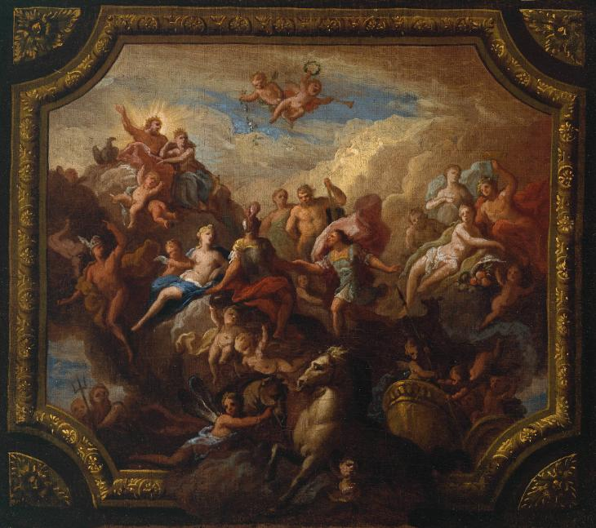
Fast-Forwarding…. Apotheosis of Romulus
Then Mars, laying aside his casque, addressed
The Father of gods and men: ‘The time has come,
Father, since now the Roman state stands firm
On great foundations, not dependent still
On one man’s power, to award the promised prize
(earned by my grandson, promised to us both),
That he be taken from earth and placed in heaven….
His mortal frame
Dissolved into the air, as leaden balls
Propelled from a broad sling melt in midsky:
Finer his features now and worthier
Of heaven’s high-raised couch…
Romulus’ wife, Hersilia, also deified as Hora,
goddess of seasons.

Slide 53
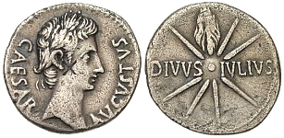
Fast-Forwarding…. Apotheosis of Julius Caesar
Making living rulers into gods was standard practice by then in Greece and the East, still taboo in Rome
Rumors that JC wanted to be made a god were partly behind his assassination, but he’s deified after his death
Ovid tells the story of Caesar’s assassination, and deification
“His words were hardly done, when Venus stood
Within the Senate-House, unseen of all,
And snatched from Caesar’s corpse the new-freed soul
Before it could dissolve into the air,
And bore it up to join the stars of heaven,
And, as she bore it, felt it glow and burn.
She launched it from her bosom. Up it flies
Above the moon, a tress of flaming fire
Streaming behind, and shines as a bright star.
Now seeing the achievements of his son,
He grants them greater than his own, well-pleased
To be surpassed….”

Slide 54
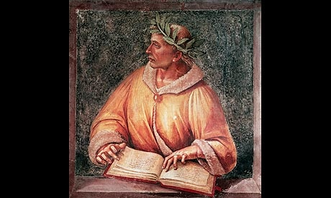
Fast-Forwarding…. The End of the Poem
Now stands my task accomplished, such a work
As not the wrath of Jove, nor fire nor sword
Nor the devouring ages can destroy.
Let, when it will, that day, that has no claim
But to my mortal body, end the span
Of my uncertain years. Yet I’ll be borne,
The finer part of me, above the stars,
Immortal, and my name shall never die.
Wherever through the lands beneath her sway
The might of Rome extends, my words shall be
Upon the lips of men. If truth at all
Is established by poetic prophecy,
My fame shall live to all eternity.

